Slide 1
DRISTI WITH STEREO VISON
Submitted by
Samanth S Mokshagundam | 1BM14EC096
Suhas G | 1BM14EC122
Suhas T Shanbhogue | 1BM14EC123
Suraj S | 1BM14EC127
Under the guidance of
Dr. B. S. Nagabhushana
Professor
Department of ECE, BMSCE

Slide 2
DEDICATION
WE WOULD LIKE TO DEDICATE OUR PROJECT TO ALL THE VISUALLY CHALLENGED PEOPLE ACROSS THE COUNTRY

Slide 3
INTRODUCTION
Vision is the single most point of information input for a multitude of animals including humans
However it is estimated that 253 million people are visually challenged and 36 million people are blind. These people are faced with a multitude of challenges even in completing normal tasks in life.
Thus autonomous navigation is of great importance to the visually challenged.
The advancement of science and technology in the recent years has enabled significant progress in providing support to disabled people.
Our project DRISTI(Dimensional Ranging by Image Segmentation and Terrain Imaging.)is one such attempt to help the blind to self-navigate by providing an effective collision detection and warning mechanism.
The principle used for obstacle detection is disparity generation based on stereo imaging.

Slide 4
OBJECTIVES
The objectives of the project are:
Obstacle detection: Segregate the foreground and the background. By utilizing the principle of depth estimation based on stereo imaging, the foreground and background of a given scene are segregated.
Localization of obstacles: Determines the region where the object is present. After determining the presence of an obstacle, the region where the obstacle is present is determined. This is a very crucial step for giving feedback to the user
Warning system: After the region of an obstacle is determined, appropriate feedback must be given to the user . We plan on providing audio feedback to the user purely because it is the most primary sense a visually challenged individual can possess.

Slide 5
PROBLEM DEFINITION
Assisting the visually challenged for indoor navigation: Obstacle detection and warning system by acoustic feedback through the use of image processing.
The objectives of the project can be subdivided as:
Obstacle detection: Segregate the foreground and the background and detect obstacles.
Warning system: Audio feedback with different tones.
It should be capable of producing different frequencies to denote various sectors of field of vision and different intensities of proximity.
Research Component: SLAM & Obstacle detection are important fields of research in the domains of Robotics and Computer Vision. Apart from that our project also attempts to research into user convenience and usefulness of such a device.

Slide 6
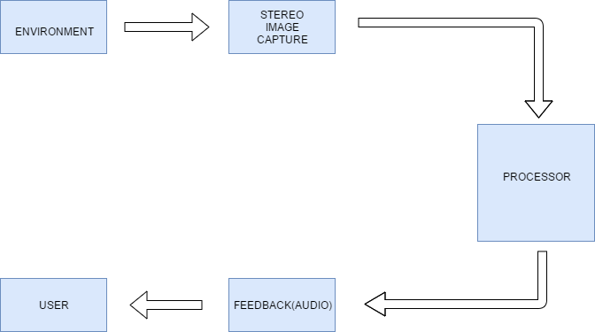
BLOCK DIAGRAM

Slide 7
BLOCK DIAGRAM
With the help of two Logitech C170 web cameras, two different perspectives of the same scene are captured.
Several image processing techniques are then applied to the image pair obtained by the processor to identify the relative proximities of potential obstacles in the captured scene.
The proximities of the obstacles are then appropriately classified and based on the region of occurrence of the obstacles, audio feedback are given to the user which help in autonomous navigation.

Slide 8
PROJECT FLOW
The project followed 2 flows. They are:
Preprocessing : This mainly consists of camera calibration and block matcher tuning.
Implementation process : This mainly consists of the Image Processing part and the feedback generation part.

Slide 9
PRE-PROCESSING
Camera Calibration
Block Matcher Tuning
Pre-processing

Slide 10
PREPROCESSING
Camera Calibration:
The Logitech C170 web cameras used suffer from radial and tangential distortions. In order to eliminate these errors, the camera intrinsic and extrinsic parameters are required. These parameters are obtained by this process.
Camera Calibration is done by providing both cameras with a well defined test pattern(we used a 7 X 10 chessboard). We provided 100 images of the same chessboard in different orientations. The object points of the chessboard corners are assumed to be some predefined values.
By determining the corners of the chessboard, the average translation between the image points and object points is estimated for all the images and based on this, the camera parameters are determined.

Slide 11
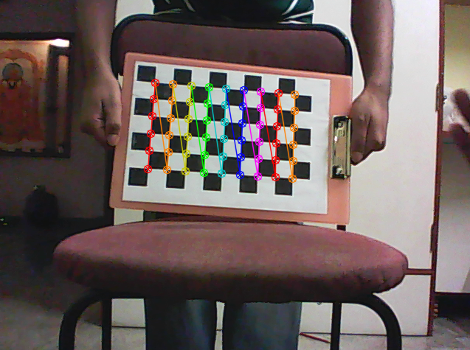
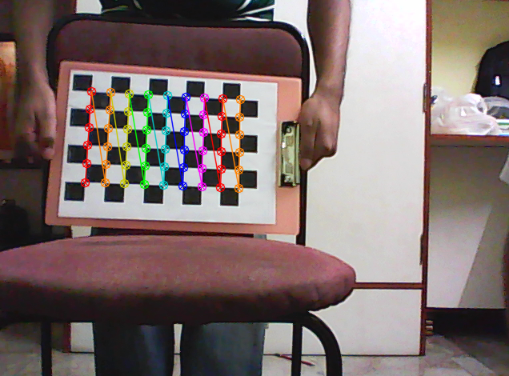
PREPROCESSING contd.
Chessboard image captured from left camera
Chessboard image captured from right camera

Slide 12
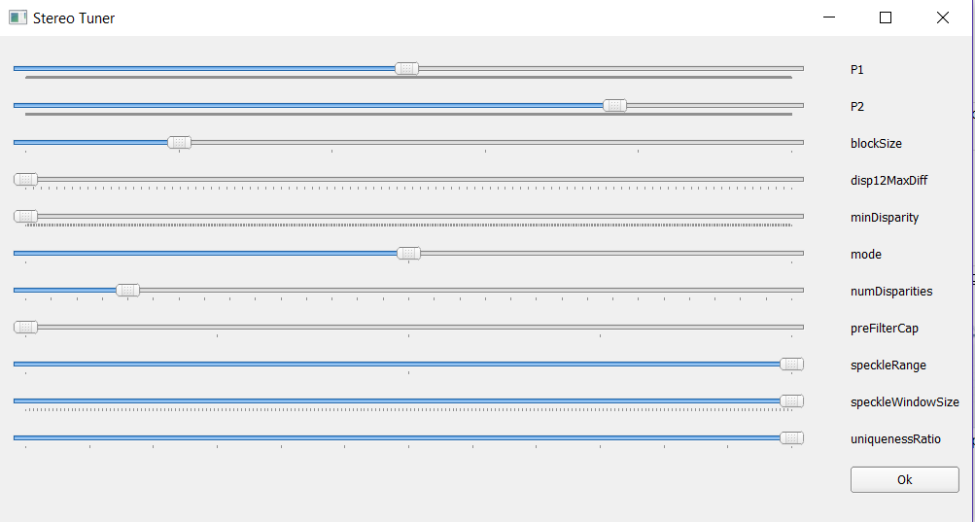
PREPROCESSING contd.
Block Matcher Tuning:
Semi Global Matching is a method which we are using to compute disparity. But it has a lot of parameters to be tuned for a particular hardware setup. So, to help in tuning we wrote an application to tune the parameters on the fly while observing the disparity. As a result, we were able to obtain the required parameters of SGBM needed for proper disparity computation.
The GUI of the block matcher is shown below.

Slide 13
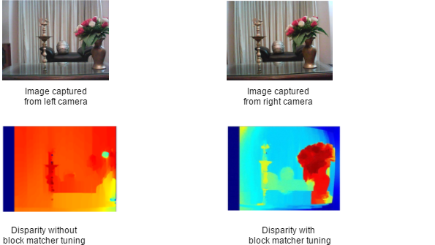
PREPROCESSING contd.

Slide 14
Implementation Process
Laptop
Server
Image Capture
Client
Raspberry Pi
Images
Undistortion&
Rectification
Feedback
Feedback
Disparity Computation
Thresholding& Segmentation
Generate Feedback Control Signal

Slide 15
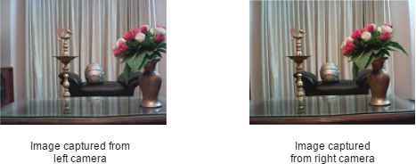
IMPLEMENTATION PROCESS
Image Capture
Using two Logitech C170 web cameras, two images each representing different perspectives of the same scene are captured. For the purpose of illustration of the concepts detailed below, we make use of a stereo image pair we have captured with the help of the web cameras we have used. The stereo image is shown below.

Slide 16
IMPLEMENTATION PROCESS
Client
We are using Raspberry Pi as the client to capture image and then convert the image to gray-scale and send it to the laptop over wireless LAN.
Raspberry Pi 3 Model B has an on board BCM43438 wireless LAN, which can be used to connect to a mobile hotspot, also to which the laptop is connected as well. Since this is a real-time application, streaming protocol based on UDP is used.
Server
Laptop acts as the server which receives the image from the raspberry pi and processes on it.
After processing, laptop sends the feedback control signal.

Slide 17
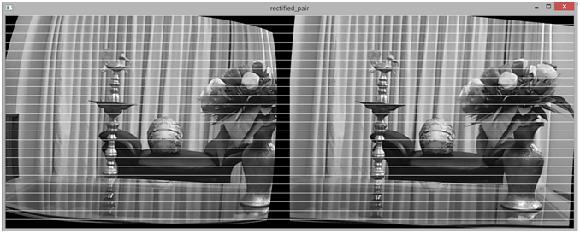
IMPLEMENTATION PROCESS
Undistortion And Rectification
With the help of the camera parameters, the images captured from both the left and right cameras are subjected to image undistortion.
The undistorted image is then subjected to rectification, where the image planes of both the captured images are made parallel to each other. The rectified image pair for the above test images are shown below.

Slide 18
IMPLEMENTATION PROCESS
Disparity Computation
The two rectified images are now used to compute the disparity corresponding to both the images.
Disparity is formally defined as the differences in x-coordinates on the image planes of the same feature viewed in the left and right cameras: x_{left}– x_{right}.
The two algorithms which are widely used for disparity computation are BM(Block Matching) and SGBM(Semi Global Block Matching). We have employed SGBM for disparity computation because SGBM offers relatively more accuracy and clarity. The disparity in both gray scale and RGB is shown below.

Slide 19
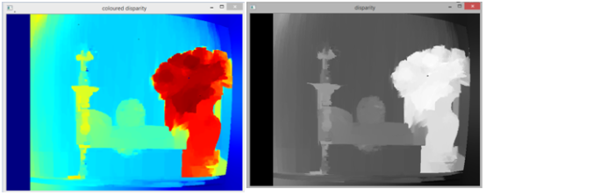
IMPLEMENTATION PROCESS contd.
Colored Disparity
Gray Scale Disparity

Slide 20
IMPLEMENTATION PROCESS
Disparity Thresholding And Segmentation
The disparity obtained is then subjected to 2-level binary thresholding indicating two levels of proximities. The proximity range for dividing the objects into these two regions is determined by the disparity intensity value.
Each of the proximity image planes obtained are then subjected to segmentation . This is done by dividing each of these image planes into appropriate number of subdivisions. Presence of objects in these subdivisions is determined by contouring. The two regions of proximities are shown below.

Slide 21
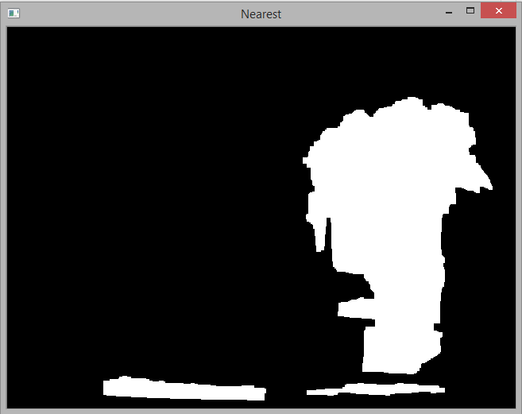
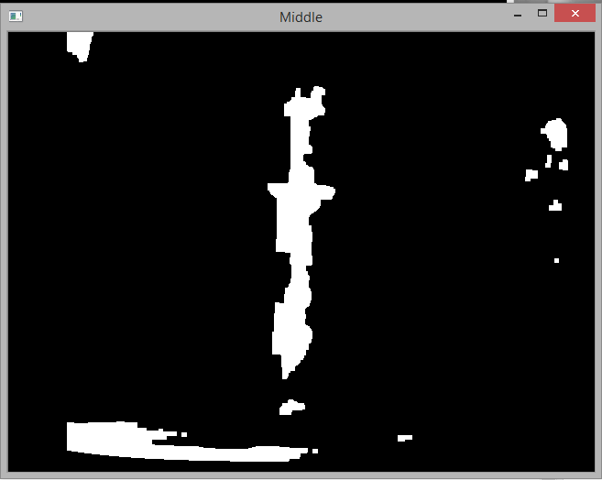
IMPLEMENTATION PROCESS
Obstacles present in “Near” proximity region
Obstacles present in “Middle” proximity region

Slide 22
IMPLEMENTATION PROCESS
Generation of feedback signals
Based on the results of segmentation, feedback signals are generated. The “Near” region being divided into three regions, will have 3 signals each corresponding to a given region. All these signals are appended into a list and the list is sent back to the client.
Providing Feedback to the user
According to signal received, appropriate frequency is generated at particular earphone side. The truth table for audio feedback delivery is given in the table below.

Slide 23
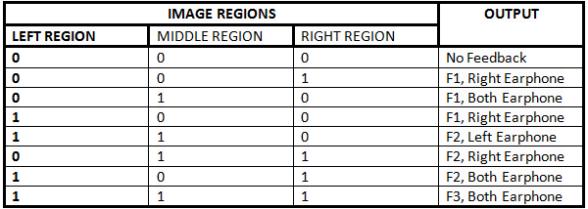
IMPLEMENTATION PROCESS

Slide 24
RESULTS
Project DRISTI works as proposed; two cameras are used to obtain live visual feed of the surroundings of a blind person. This is given as input to the Raspberry Pi, which computes a gray scale version of the image and sends it to the laptop over a Local Area Network for further computation. The laptop is used to calculate disparity from the two camera using SGBM algorithm.
When the blind person encounters an object the disparity and the feedback signals calculated by the laptop will be utilised by the Raspberry Pi to give an acoustic feedback based on the proximity of the said object.
Depending upon which ear gets the audio signal and also upon the frequency of the signal the number of objects and the region/s in which the object is present can be determined. The user can use this data to avoid the obstacle.

Slide 25
BENEFITS
Obstacle detection at a distance: One of the major advantages is that the blind person will be able to identify the presence of an object from a distance without having to come in contact with the obstacle.
Reduced human error: as the primitive walking stick is replaced with more accurate technology there is reduction in error, both false positives and false negatives, for obstacle detection.
Ease of navigation: Indoor navigation as well as outdoor navigation is made easier.
Saves time: Navigation time from one place to another is reduced with the help of this too.

Slide 26
FUTURE WORK
Pothole detection: This methodology would be of utmost help, especially in badly maintained places and roads, where the potholes are left open and the blind people could fall of in case not warned about the same.
Obstacle recognition: This can be implemented by machine learning wherein the user is not only warned about the type of obstacle in front, so that he or she is further aware of what exactly what is in front of him/her.
Gradient detection: Any sudden change of slope is also dangerous for navigation and in this case too, if no proper warning has been given to the people, then there is a high chance of tripping and falling off if hands free.

Slide 27
REFERENCES
Alberto Rodríguez, J. Javier Yebes, Pablo F. Alcantarilla, Luis M. Bergasa, Javier Almazan and Andrés Cela, Assisting the Visually Impaired: Obstacle Detection and Warning System by Acoustic Feedback, Open Access, Sensors, ISSN 1424-82.
Cosmin D. Pantilie, SilviuBota, Istvan Haller and SergiuNedevschi, Real-time Obstacle Detection Using Dense Stereo Vision and Dense Optical Flow, 978-1-4244-8230-6/10/$26.00 ©2010 IEEE
Raphael Labayrade, Didier Aubert, Jean-Philippe Tarel, Real Time Obstacle Detection in Stereovision on Non Flat Road Geometry Through "V-disparity" Representation.
Van-Nam Hoang, Thanh-HuongNguyen,Thi-Lan Le, Thanh-Hai Tran, Tan-PhuVuong, Nicolas Vuillerme, Obstacle detection and warning system for visually impaired people based on electrode matrix and mobile Kinect, Open Access at Springer 26 July 2016
AniketMurarka, Mohan Sridharan, Benjamin Kuipers,Detecting Obstacles and Drop-offs using Stereo and Motion Cues forSafe Local Motion,published athttps://web.eecs.umich.edu/~kuipers/

Slide 28
THANK YOU

